Slide 1

Data analysis with SPSS for Beginners By- Dr. Mudit Kumar Singh Visiting Research Fellow, Duke University (http://muditsingh.netlify.app/)
Topics
Data entry and coding
Descriptive analysis (frequency, correlation, tabulation)
Simple regression in SPSS.
Schedule
09-11 Nov, 2020 evening 5:30- 6:30 PM IST

Slide 2
How and what will we do?
Power point and SPSS will go hand-in-hand
Ask questions (preferably in chat)
Verbal discussion later in the day, if time permits
Home work at the end of the session each day
Resource materials via email

Slide 3
Data analysis
Before we begin
Research Methods/Statistics
Data collection
Accesses to SPSS

Slide 4
Know your Data
Sources (relevant for writing)
Types (highly relevant for analysis)
Nominal (Names, social classes)
Ordinal (Ordered groups)
Scale
Interval (can be below zero)
Ratio (not below zero)
Other frequently used terms
Categorical (data with categories can be ordinal/nominal)
Dummy Variables/Dummy coding (0 and 1)

Slide 5
Preparing your Data
Task | Associated SPSS Options
Coding | Variable view
Feeding/entry | Data view
Editing | Transform/Data
Checking Distribution | Analyze->Descriptive Statistics

Slide 6
Some Common Analysis
Data Type | Averages | Common Analysis
Nominal Data | Mode | Frequency, test of independence
Ordinal | Median | Rank Correlation, test of independence
Interval | Arithmetic Mean | Standard Deviation, Karl Pearson’s Correlation.
Ratio Scale | Arithmetic Mean, Geometric Mean, Harmonic Mean | Coefficient of Variation and other parametric tests

Slide 7
Reminding Key Terms
Distribution
Normal (widely used)
Mean, standard deviation (SD) and standard error (SE)
Hypothesis
Null (no difference)
Alternative (different)
Significance
α (probability of avoiding Type I error)
β (probability of avoiding Type II error)

Slide 8
Home work
From your dataset
Select any nominal data other than gender and build dummy codes for each sub-category.
Visualize the combination of the all the above variables
Select at least two scale variables from your data, write hypothesis to test for their normality. What do you conclude?

Slide 9
Recap of Day 1
Task | Associated SPSS Options
Coding | Variable view
Feeding/entry | Data view
Editing | Transform/Data

Slide 10
Reminding Key Terms
Distribution
Normal (widely used)
Mean, standard deviation (SD) and standard error (SE)
Hypothesis
Null (no difference)
Alternative (different)
Significance
α (probability of avoiding Type I error)
β (probability of avoiding Type II error)

Slide 11
Some Common Analysis
Data Type | Averages | Common Analysis
Nominal Data | Mode | Frequency, test of independence
Ordinal | Median | Rank Correlation, test of independence
Interval | Arithmetic Mean | Standard Deviation, Karl Pearson’s Correlation.
Ratio Scale | Arithmetic Mean, Geometric Mean, Harmonic Mean | Coefficient of Variation and other parametric tests

Slide 12
Nominal/Ordinal
Frequency
Test of independence

Slide 13
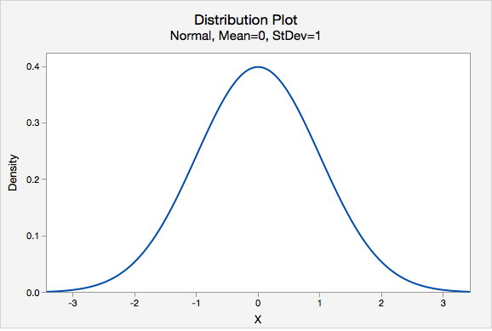
Scale
Correlation
Test of Normality

Slide 14
Summary
Homework
Tomorrow’s session

Slide 15
Recap
Task | Associated SPSS Options
Coding | Variable view
Feeding/entry | Data view
Editing | Transform/Data
Analyzing | Analyze->Descriptive Statistics

Slide 16
Analysis: Descriptive
Analyze->Descriptive Statistics
Frequency
Crosstab
Test of Independence (Chi-square)
Correlation
Charts
Explore
Normality and other small statistics

Slide 17
Linear Regression
Analyze->Regression->Linear
Important Statistics
Estimates
Model fit
Collinearity and residual (Y) * Pred (X) plot
Output tables
ANOVA
Model summary
Coefficients table (scores and model fit)
Collinearity diagnostic (E>0, Condition index<15)

Slide 18
Trouble with Linear Regression
Mutlicollinearity
Treatment (use z-scores and try replacing unimportant variables)
To improve VIF (lowering VIF)
Try factor analysis
Transformation or removal of variables

